Slide 1
Relationship between Chronic Intermittent Hypoxia and Intraoperative Mean Arterial Pressure in Obstructive Sleep Apnea Patients Having Laparoscopic Bariatric Surgery
Hannah Culver

Slide 2
Terminology

Slide 3
Medical Terms
trocar
hypoxia
hypopnea
hypoxemia
hypotension
baroreceptor
vasopressors
intraoperative
cardiovascular
polysomnography
pneumoperitoneum
oxyhemoglobin saturation
laparoscopic bariatric surgery
sympathetic adrenergic activity
Notes:
trocar: a surgical instrument with a three-sided cutting point enclosed in a tube, used for withdrawing fluid from a body cavity
hypoxia: low levels of oxygen in your body tissues
hypopnea: abnormally slow or shallow breathing (while a hypopnea is a period of shallow breathing, an apnea is a complete pause in breathing)
hypoxemia: a below-normal level of oxygen in your blood, specifically in the arteries
hypotension: low blood pressure occurs when blood flows through your blood vessels at lower than normal pressures (hyper = high)
baroreceptor: a type of mechanoreceptors allowing for relaying information derived from blood pressure within the autonomic nervous system (measures blood pressure)
vasopressors: a powerful class of drugs that induce vasoconstriction and thereby elevate mean arterial pressure (ephedrine, epinephrine, phenylephrine)
intraoperative: occurring or performed during the course of a surgical operation (pre = before, post = after)
cardiovascular: relating to the heart and blood vessels
polysomnography: a comprehensive test used to diagnose sleep disorders
pneumoperitoneum: the presence of air or gas in the abdominal (peritoneal) cavity
oxyhemoglobin saturation: the percentage of oxygen in your blood (desaturation = lower than it should be)
laparoscopic bariatric surgery: a surgical procedure that involves the creation of a gastric pouch and is performed to yield significant and long-lasting weight loss in patients who are severely obese (gastric bypass surgery)
sympathetic adrenergic activity: causes vasoconstriction of most blood vessels, including many of those in the skin, the digestive tract, and the kidneys (sympathetic = having to do with the nervous system)

Slide 4
Terms (cont.)
a priori
post hoc
confounders
consequent to
confidence interval
multivariable regression model
retrospective observational study
Notes:
a priori: knowledge considered to be true without being based on previous experience or observation (from the previous)
post hoc: after this (after the event)
confounder: an extraneous variable whose presence affects the variables being studied so that the results do not reflect the actual relationship between the variables under study
consequent to: a consequent to b (a is happening as a result of b)
confidence interval: indicates where the population parameter is likely to reside (for example - with a 95 percent confidence interval, you have a 5 percent chance of being wrong)
multivariable regression model: used to establish the relationship between a dependent variable (i.e. an outcome of interest) and more than 1 independent variable (logistic regression, support vector machines, neural networks, etc.)
retrospective observational study: non-randomised, non-interventional analyses of existing data relating to patients, care received and outcomes

Slide 5
Goals
Using what we have learned in our data science tutorial…
Notes:
recreate the clinic data as best we can
conduct further study of particular interest

Slide 6
Abstract

Slide 7
Abstract
Background: Recurrent nocturnal hypoxemia in obstructive sleep apnea enhances sympathetic function, decreases baroreceptor sensitivity, and weakens peripheral vascular responses to adrenergic signals. The authors hypothesized that the percentage of total sleep time spent at oxyhemoglobin saturation (SaO₂) less than 90% and minimum nocturnal SaO₂ on preoperative polysomnography are associated with decreased intraoperative mean arterial pressure.
Methods: The authors examined the records of all patients who had laparoscopic bariatric surgery at Cleveland Clinic between 2005 and 2009 and an available polysomnography study. The authors assessed the relationships between the percentage of total sleep time spent at SaO₂ less than 90% and minimum nocturnal SaO₂, and the time-weighted average of mean arterial pressure. The authors used multivariable regression models to adjust for prespecified clinical confounders.
Results: Two hundred eighty-one patients were included in the analysis. The average change in the time-weighted average of mean arterial pressure was −0.02 (97.5% CI, −0.08, 0.04) mmHg for each 1% absolute increase in the percentage of sleep time spent at SaO₂ less than 90% (P = 0.50). The average change was −0.13 (97.5% CI, −0.27, 0.01) mmHg, for each 1% absolute decrease in the minimum SaO₂ (P = 0.04 > significance criterion of 0.025, Bonferroni correction). An unplanned analysis estimated 1% absolute decrease in minimum SaO₂ was associated with −0.22 (98.75% CI, −0.39, −0.04) mmHg, change in mean arterial pressure (P = 0.002) in the time period between endotracheal intubation and trocar insertion.
Conclusion: Recurrent nocturnal hypoxemia in obstructive sleep apnea is not a risk marker for intraoperative hypotension.

Slide 8
Materials and Methods

Slide 9
Patients
eligible were all patients who had laparoscopic bariatric procedures between June 2005 and December 2009 and had a diagnosis of OSA with a polysomnography study performed within two preoperative years
patients 1) who did not have a polysomnography report available and/or those whose polysomnography reports were missing critical exposure variables such as the percentage of total sleep time spent at SaO₂ less than 90%, or minimum nocturnal SaO₂, 2) missing any of the prespecified potential confounders, and 3) with severe cardiopulmonary disease associated with respiratory insufficiency and/or requiring oxygen supplementation during daytime or sleep were excluded
the apnea/hypopnea and arousal indices were estimated by dividing the number of all events occurring during sleep with the total sleep time calculated as the sum of all sleep stage periods

Slide 10
Anesthetic Management
Vasopressors such as ephedrine, phenylephrine, or epinephrine were used to maintain blood pressure within 20% of preoperative level.

Slide 11
Outcomes and Exposures
time-weighted average intraoperative MAP was the main outcome in our analysis
our main exposure variables were the percentage of total sleep time spent at SaO₂ less than 90% and the minimum nocturnal SaO₂ listed in polysomnography reports, two parameters indicating the nocturnal oxygenation status of the patients with OSA

Slide 12
Statistical Analysis
the time-weighted average of MAP is equal to the sum of the portion of each time interval in-between two adjacent MAP measurements multiplied by the average of the corresponding two MAP measurements and divided by the time interval between the first and the last MAP measurements
11 potential confounders including age, sex, race, body mass index, smoking status, diabetes mellitus, hypertension, coronary artery disease, preoperative use of antihypertensive medications, continuous positive airway pressure therapy, and type of bariatric surgery

Slide 13
Secondary Analyses

Slide 14
Secondary Analyses
also evaluated the relationship between percentage of total sleep time spent at SaO₂ less than 90% and minimum nocturnal SaO₂, and intraoperative use of vasopressor (yes vs. no), including ephedrine, epinephrine, and phenylephrine, each using a multivariable logistic regression
among patients who received vasopressor, further assessed the relationship between percentage of total sleep time spent at SaO₂ less than 90% and minimum nocturnal SaO₂, and the total dose of vasopressor, using a multivariable regression model
also conducted four unplanned exploratory analyses focusing on the associations between the percentage of total sleep time spent at SaO₂ less than 90% and minimum nocturnal SaO₂, and the intraoperative time-weighted average of MAP, separately for the time periods spanning from endotracheal intubation to trocar insertion and from trocar insertion until the end of case, using the same statistical methods as in the primary analysis

Slide 15
Results

Slide 16
Secondary Analyses
receiving vasopressor was not significantly associated with either percentage of total sleep time spent at SaO2 less than 90% (P = 0.86) or minimum nocturnal SaO2 (P = 0.39)
the estimated average change in the total dose of vasopressor was −3 (97.5% CI, −14 to 8) μg for each 1% absolute increase in the percentage of total sleep time spent at SaO2 less than 90% (P = 0.59), after adjusting for age, sex, and preoperative use of antihypertensive medications
the estimated change in the dose was 9 (−16, 34) μg for each 1% absolute decrease in the minimum nocturnal SaO2 (P = 0.41), after adjusting for age, sex, smoking, diabetes, and preoperative use of antihypertensive medications

Slide 17
Exploratory Analyses
consistently with our primary analysis, found that neither the percentage of total sleep time spent at SaO₂ less than 90% nor the minimum nocturnal SaO₂, was associated with time weighted average of MAP, during the period spanned from trocar insertion to end of case
however, the lower minimum nocturnal SaO₂ in the preoperative polysomnography was significantly associated with lower time-weighted average of MAP during the time period spanned from endotracheal intubation to trocar insertion (P = 0.002)

Slide 18
Discussion

Slide 19
Discussion
After adjusting for prespecified potential confounders, intermittent nocturnal hypoxia (measured by the percentage of total sleep time spent at SaO₂ less than 90% and the minimum nocturnal SaO₂) was not significantly associated with intraoperative MAP during laparoscopic bariatric surgery in patients suffering from OSA.

Slide 20
Jupyter Hub
reference material for our markdown document

Slide 21
Bar Graphs

Slide 22
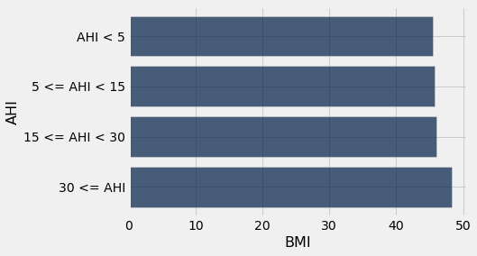
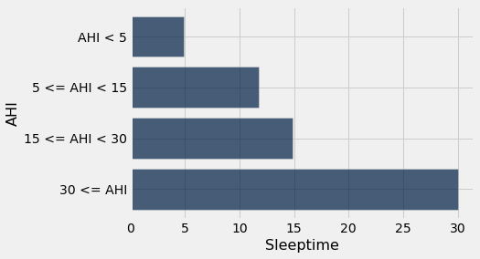
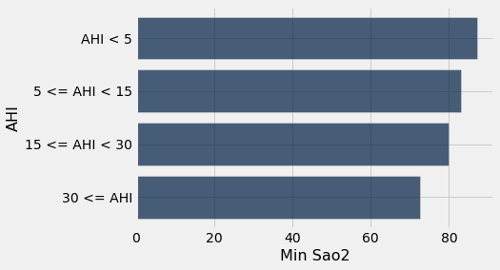
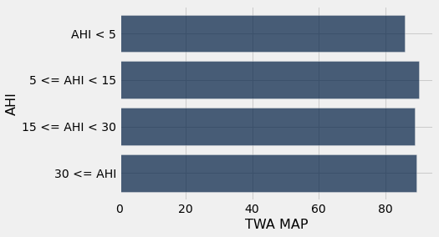
in_order.select("BMI", "AHI").barh("AHI")
in_order.select("Sleeptime", "AHI").barh("AHI")
in_order.select("Min Sao2", "AHI").barh("AHI")
in_order.select("TWA MAP", "AHI").barh("AHI")

Slide 23
Correlation Coefficient r

Slide 24
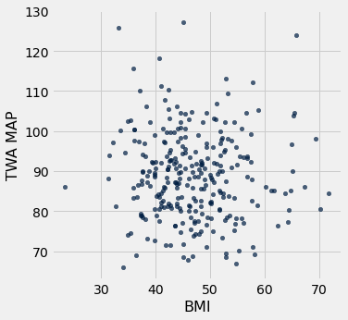
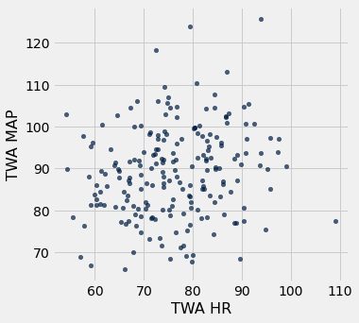
No Correlation (r=0)

Slide 25
Classification

Slide 26
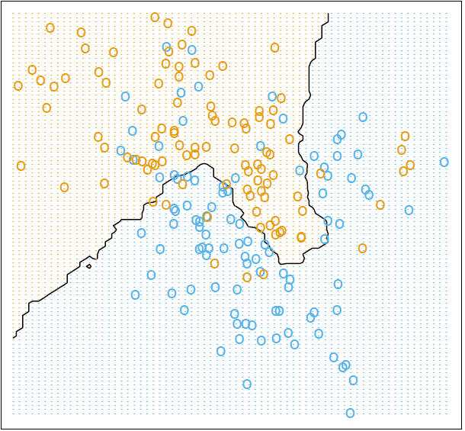
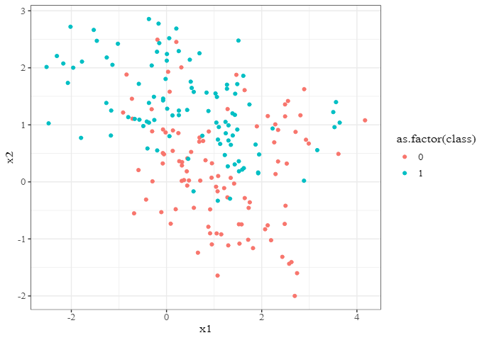
k-Nearest Neighbors

Slide 27
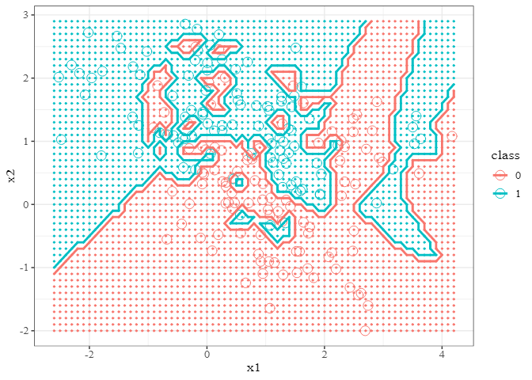
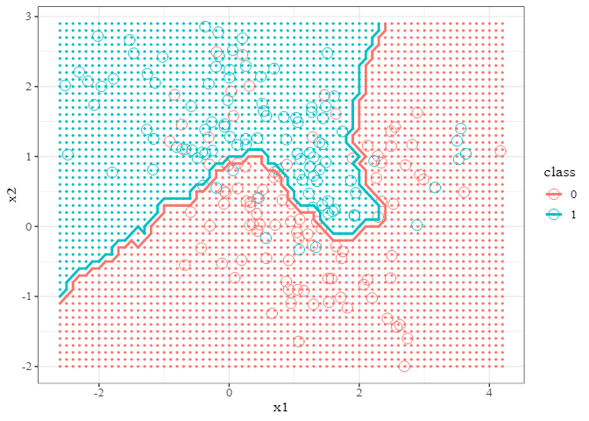
Decision Boundary
k = 1
k = 15

Slide 28
Markdown Tips & Tricks

Slide 29
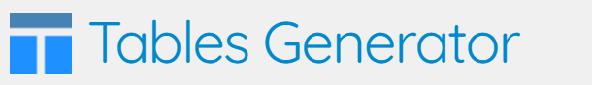
Formatting
Make sure you select Markdown from the dropdown menu!
headers #
bold, italic *text* or **text**
lists, quotes * text or > text
links [title](url)
pictures ![title](image address)
lines, font sizes --- or \size
LaTex (mathematical symbols and equations) $math$ (inline) or $$math$$ (display)
Tables Generator (click here)

Slide 30
Questions?
Thank you!

